Slide 1
STANDARDS IN HPC
There and Back

Slide 2
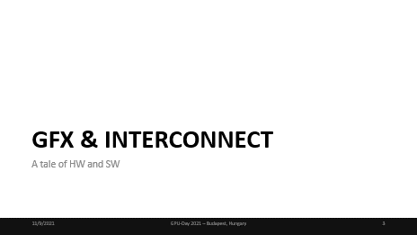
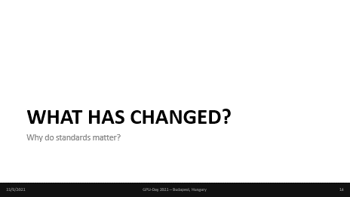
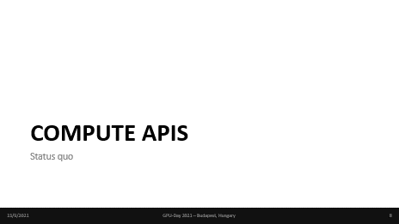
TABLE OF CONTENTS

Slide 3
GFX & INTERCONNECT
A tale of HW and SW

Slide 4



INTER-NODE COMMUNICATION
To go beyond the compute capacity of what a single memory coherent node has to offer, inter-node communication has become the norm.
  MPI has long been the defining standard in this domain
  The MPI Forums handles
  Contenders (eg. HPX, ØMQ) define slightly different comm semantics.
Extending the size of „memory coherent” domains is the subject of NUMA architectures
  Not many NUMA architectures compete in the chase of exaFLOPS.
GFX & INTERCONNECT

Slide 5

INTERCONNECT TECHNOLOGIES
Mellanox’s InfiniBand network interfaces have become the default interconnect on post-Ethernet speeds.
Even though in HPC clusters, InfiniBand reigns/ed supreme, code using it is still vendor-neutral.
Since Nvidia’s acquisition of of Mellanox, competitors have stirred up the interconnect space
  CXL, CCIX, OpenCAPI, etc.
Vendors implement their NICs which conform to these standards
  Intel OmniPath
  AMD InfinityFabric
  …
GFX & INTERCONNECT

Slide 6
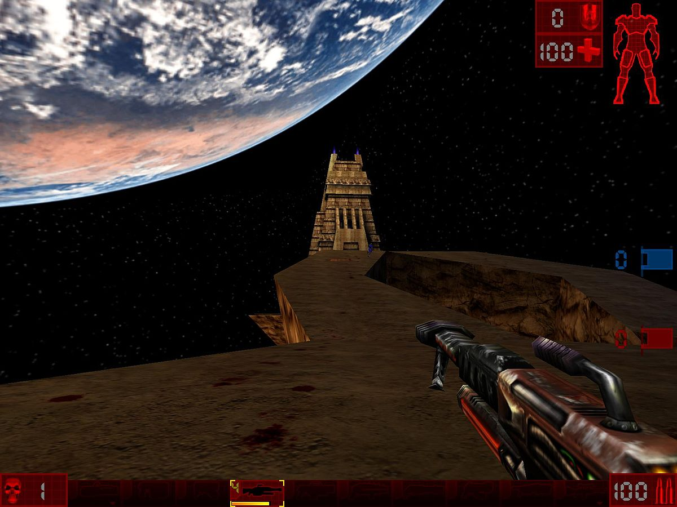
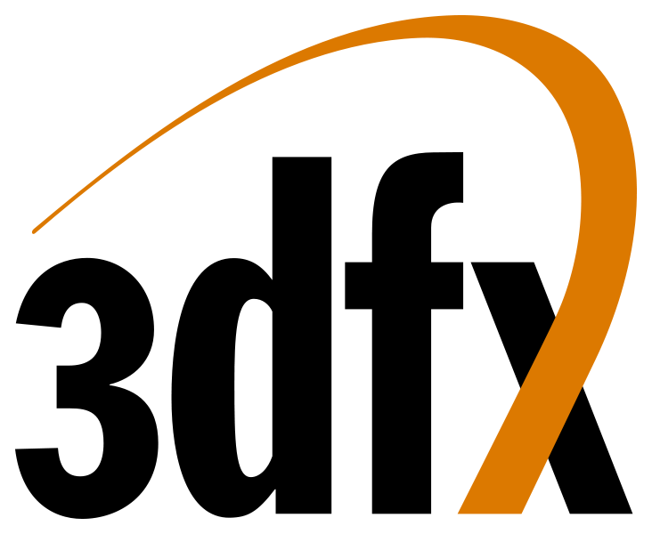
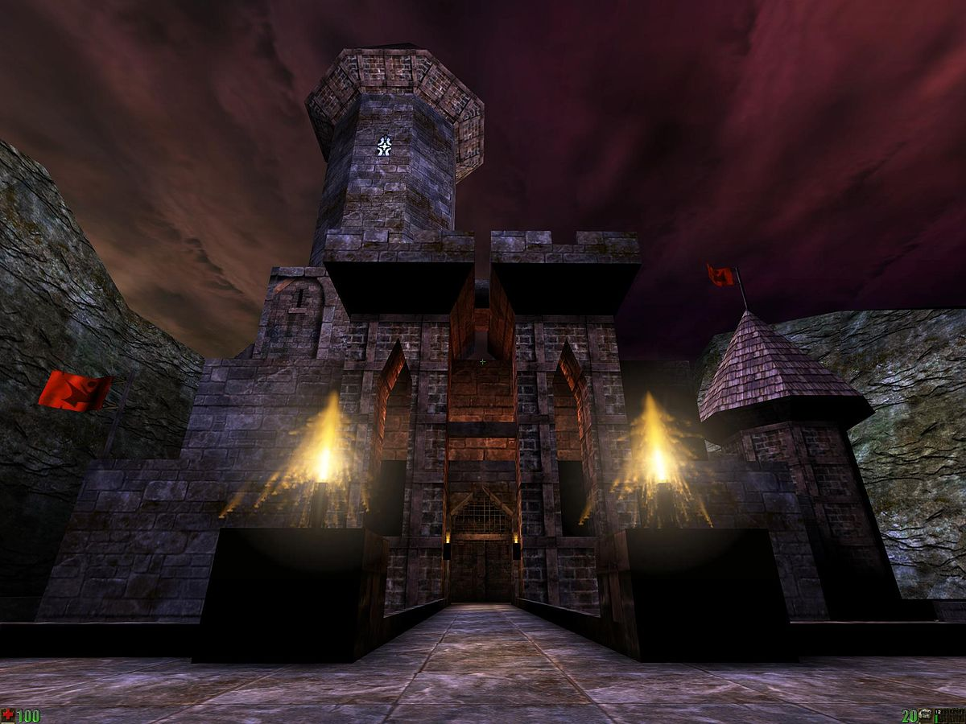

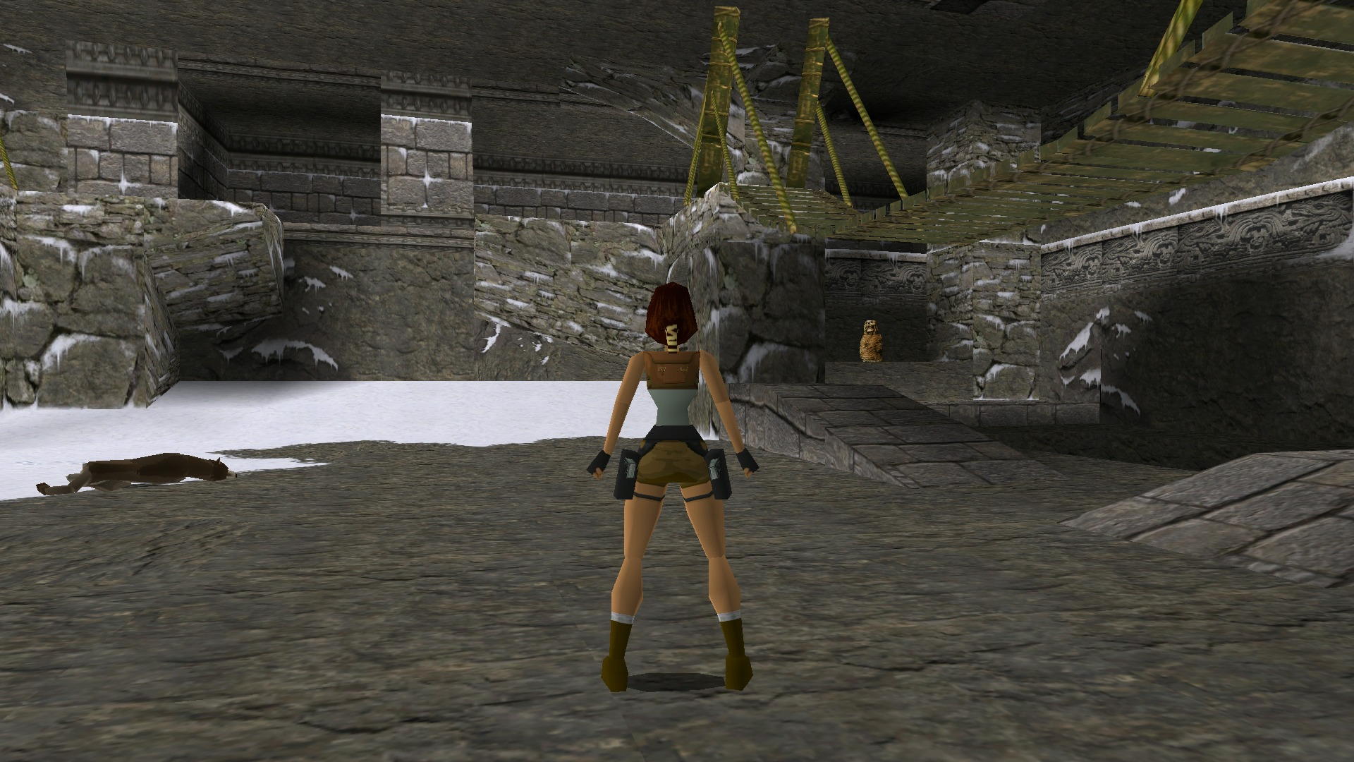
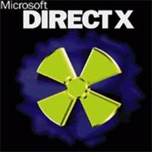
GRAPHICS TECHNOLOGIES
1st generation graphics cards
Initially a handful of APIs competed to dominate the gaming industry
From the competing technologies, only the cross-vendor ones remain to date
  (3dfx was acquired by Nvidia)
GFX & INTERCONNECT

Slide 7
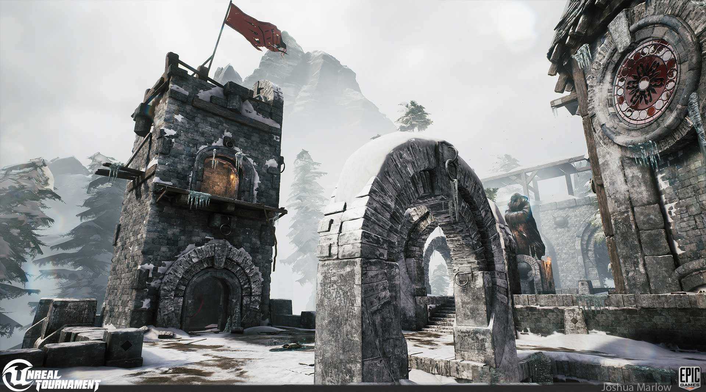



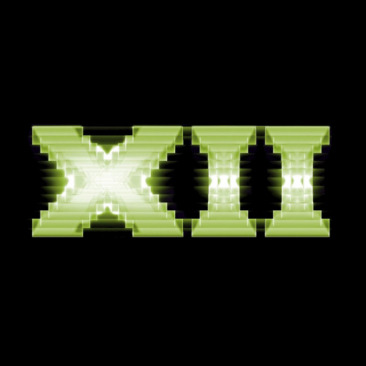
GRAPHICS TECHNOLOGIES
Fast forward, platform APIs remain, alongside industry standards remain in use
Consensus of vendors doesn’t conflict with competition and innovation
Ultimately both developers and end-users benefit
9th generation grahpics cards
GFX & INTERCONNECT
More on this later…

Slide 8
COMPUTE APIS
Status quo

Slide 9

CURRENT MONOCULTURE
”
We’ll use Ubuntu as the OS because the underlying enablement for GPGPUs ‘Just Works’ in all the clouds and with all the local hardware, and making docker images on Ubuntu ensures that the CUDA libraries line up with the drivers properly.
”
COMPUTE APIS
Persistent CUDA haegemony has claimed sole ownership of an entire domain in the eye of public perception.
https://twitter.com/ubuntu/status/1072479048201318401?s=20

Slide 10
UNDERSTANDING THE DEFAULTS
Nvidia has been a constant pioneer in the domain of GPGPU algorithms
  Not the sole pioneer, but by far with the largest investment
In the past 15 years, the CUDA ecosystem has gained a reputation for it’s stability
Wide assortment of performant, turn-key ready domain libraries has won the hearts of many scientists.
Comfortable programming model
Partnership programs provide up-front benefits (!)
COMPUTE APIS

Slide 11
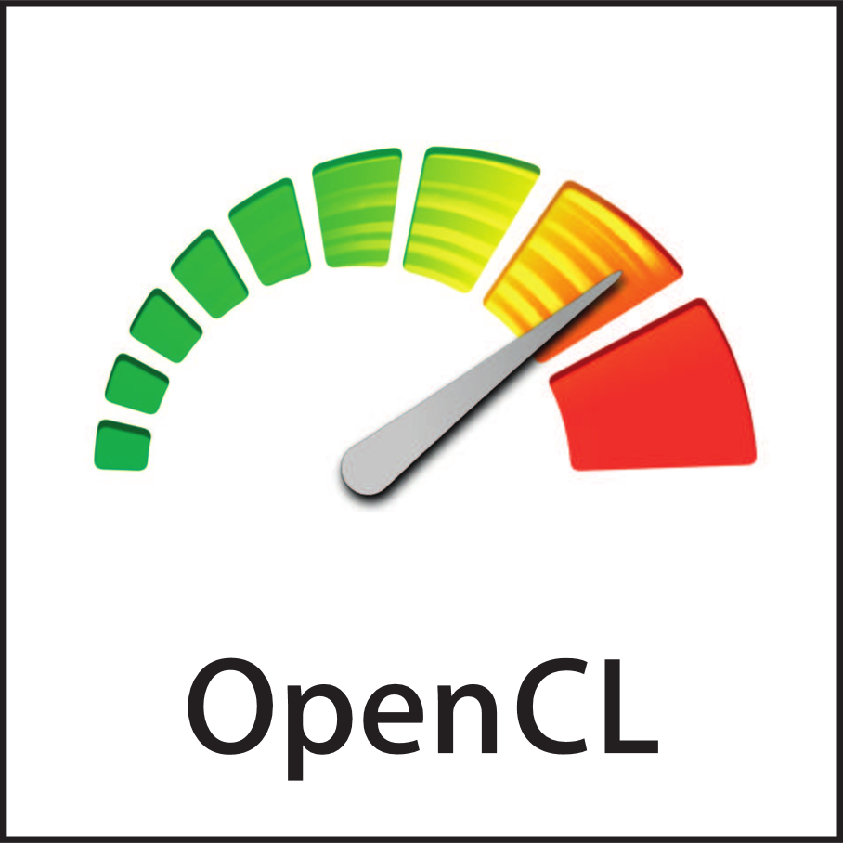
MANY HAVE TRIED…
OpenCL has been one of the most persistent contenders in breaking the monoculture
  Market penetration is/has been below expectation
ABI and programming model is still favored to this day
  Not just for GPGPU
  Custom embedded
  AI accelerators
  DSPs
COMPUTE APIS

Slide 12
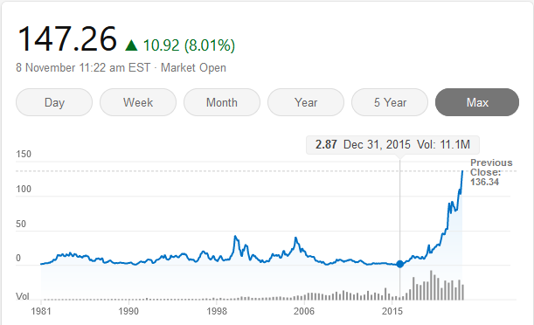
CUDA TO HIP
”
The Heterogeneous Interface for Portability (HIP) is AMD’s dedicated GPU programming environment for designing high performance kernels on GPU hardware
HIP is a C++ runtime API and programming language that allows developers to create portable applications on AMD and NVIDIA platforms
This means developers can write their GPU applications and with very minimal changes be able to run their code in either environment
Syntax wise, HIP is similar to CUDA and has virtually no performance overhead on NVIDIA systems
HIP includes a rich set of libraries and tools support
COMPUTE APIS
Launch of GPUOpen, alongside initial HIP release in 2016 Jan
”
https://developer.amd.com/wp-content/resources/ROCm%20Learning%20Centre/chapter3/HIP-Coding-3.pdf

Slide 13
JUST 2 VENDORS FOR A MOMENT
Target GPUs and CPUs
How many back-ends do I need?
  CUDA
  HIP
  HIP-CPU
  (Vanilla ISO C/C++?)
3-4 codes to execute on typical systems
  Not even including Intel HW
Isn’t there a better way?
  OpenCL already did this. 10 years ago
COMPUTE APIS

Slide 14
WHAT HAS CHANGED?
Why do standards matter?

Slide 15
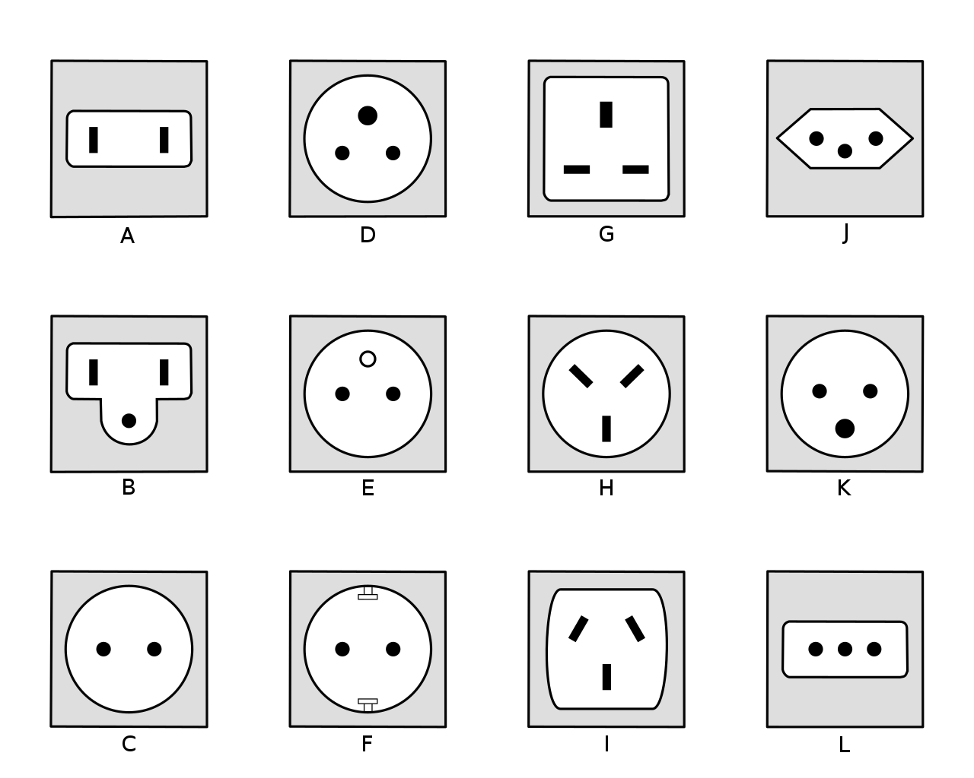
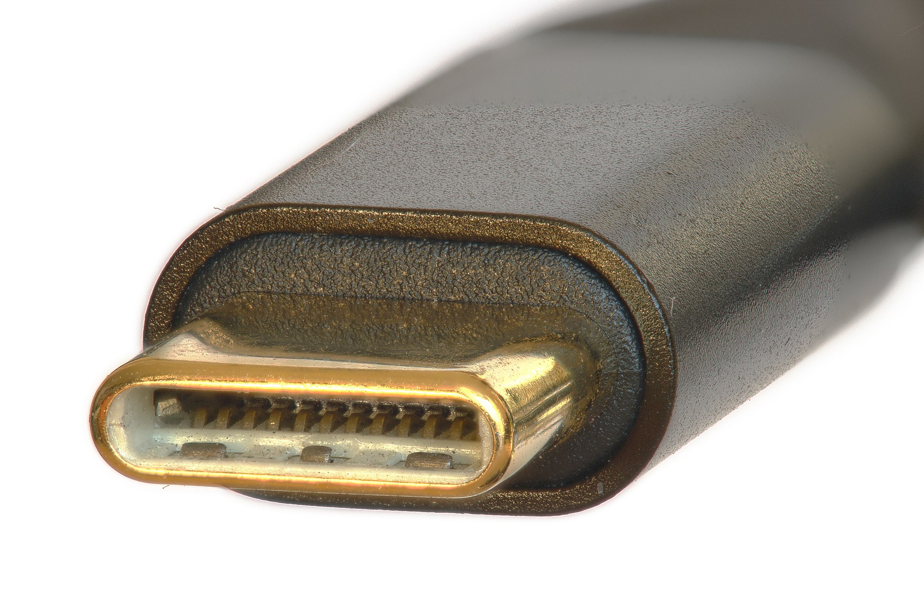
WHY DO STANDARDS MATTER?
Standard
Plurality
WHAT HAS CHANGED?
https://commons.wikimedia.org/wiki/File:USB-C_plug,_focus_stacked.jpg
https://commons.wikimedia.org/wiki/File:Plug_types.svg

Slide 16

OPENCL 3.0
Re-imagination of the API
Builds on top of the last widely adopted version, 1.2
Adopts the Vulkan-like „slim core API with everything else extensions” approach
Lowers the bar for adoption
  Newcomers
  Solves issues for existing adopters
WHAT HAS CHANGED?

Slide 17
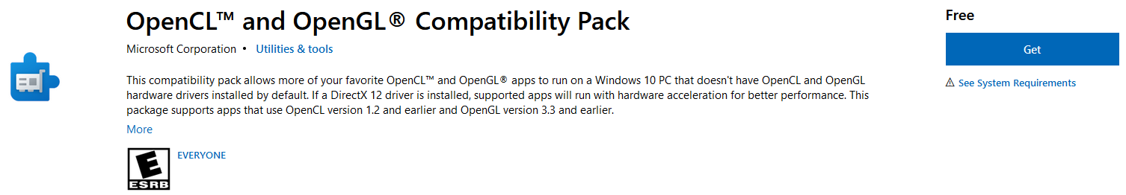
OPENCL 3.0 ECOSYSTEM REBOOT
New ICD Layers capability allows augmenting/modifying runtime behavior
  Add missing features, validate correctness, trace, profile, etc
OpenCL SDK serves as a „one-stop shop” for devs
  Initial batch of native samples & utilities awarded to Stream
    Coming to a GitHub near you
Defines the semantics of layered implementations to fill in the gaps of platform support
  Most notably OpenCLOn12, enabling OpenCL across the entire Windows ecosystem, regardless of vendor support.
WHAT HAS CHANGED?
https://www.microsoft.com/en-us/p/opencl-and-opengl-compatibility-pack/9nqpsl29bfff

Slide 18
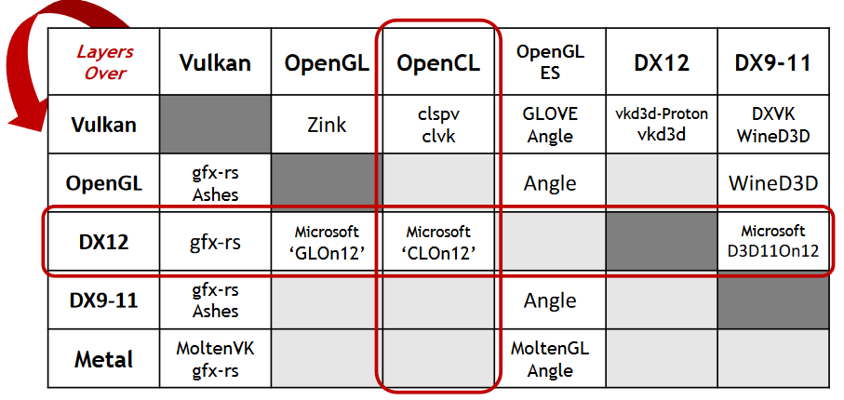
API LAYERING
Low level APIs allow implementing one over the other
Re-introduces the N*M problem
  Vendors are still encouraged to have 1st party support
SYCL implementations not noted here
WHAT HAS CHANGED?
Neil Trevett – State of the Union
https://www.khronos.org/assets/uploads/developers/presentations/OpenCL-Update-IWOCL-Apr21_1.pdf
© The Khronos® Group Inc.

Slide 19
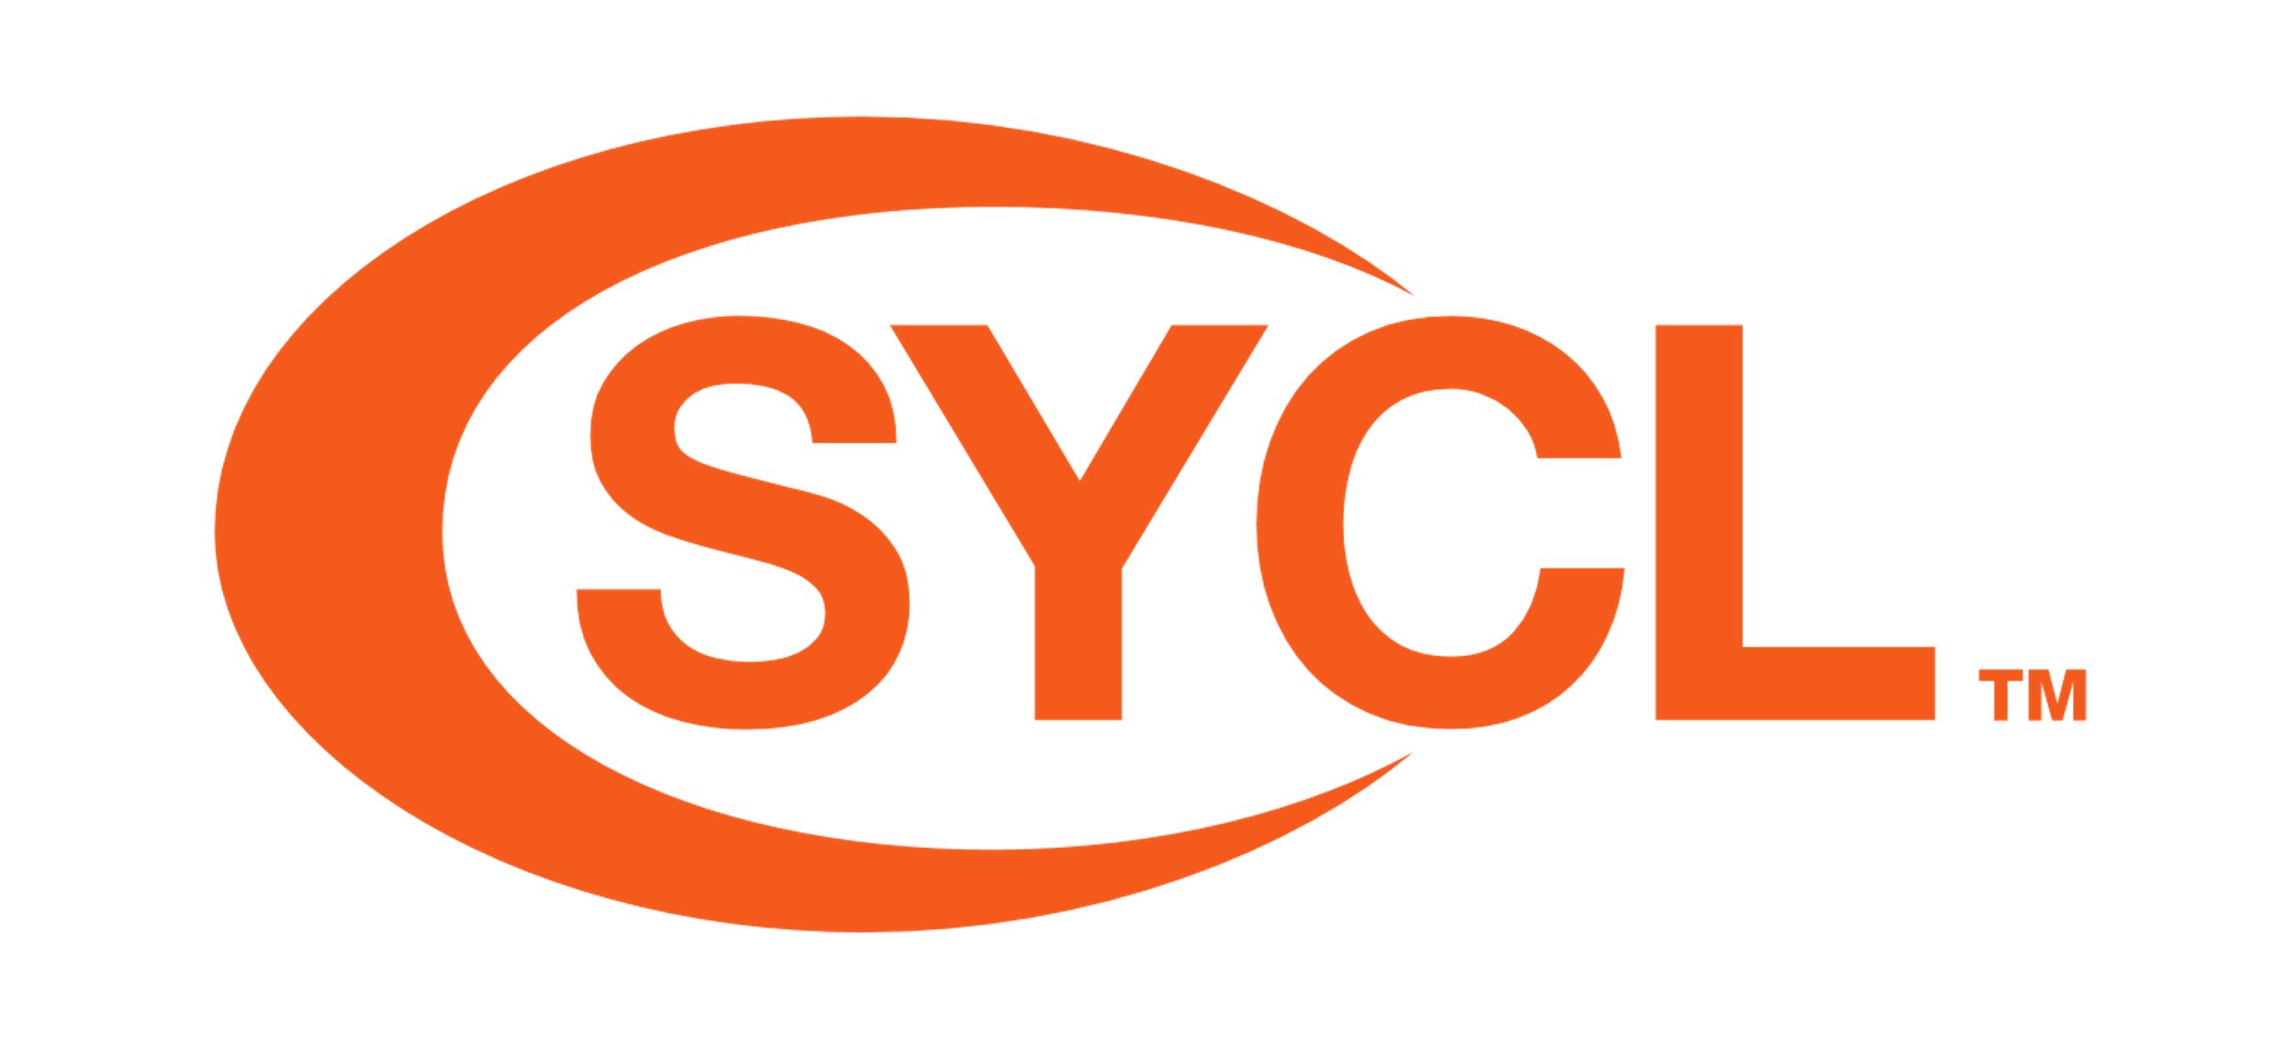
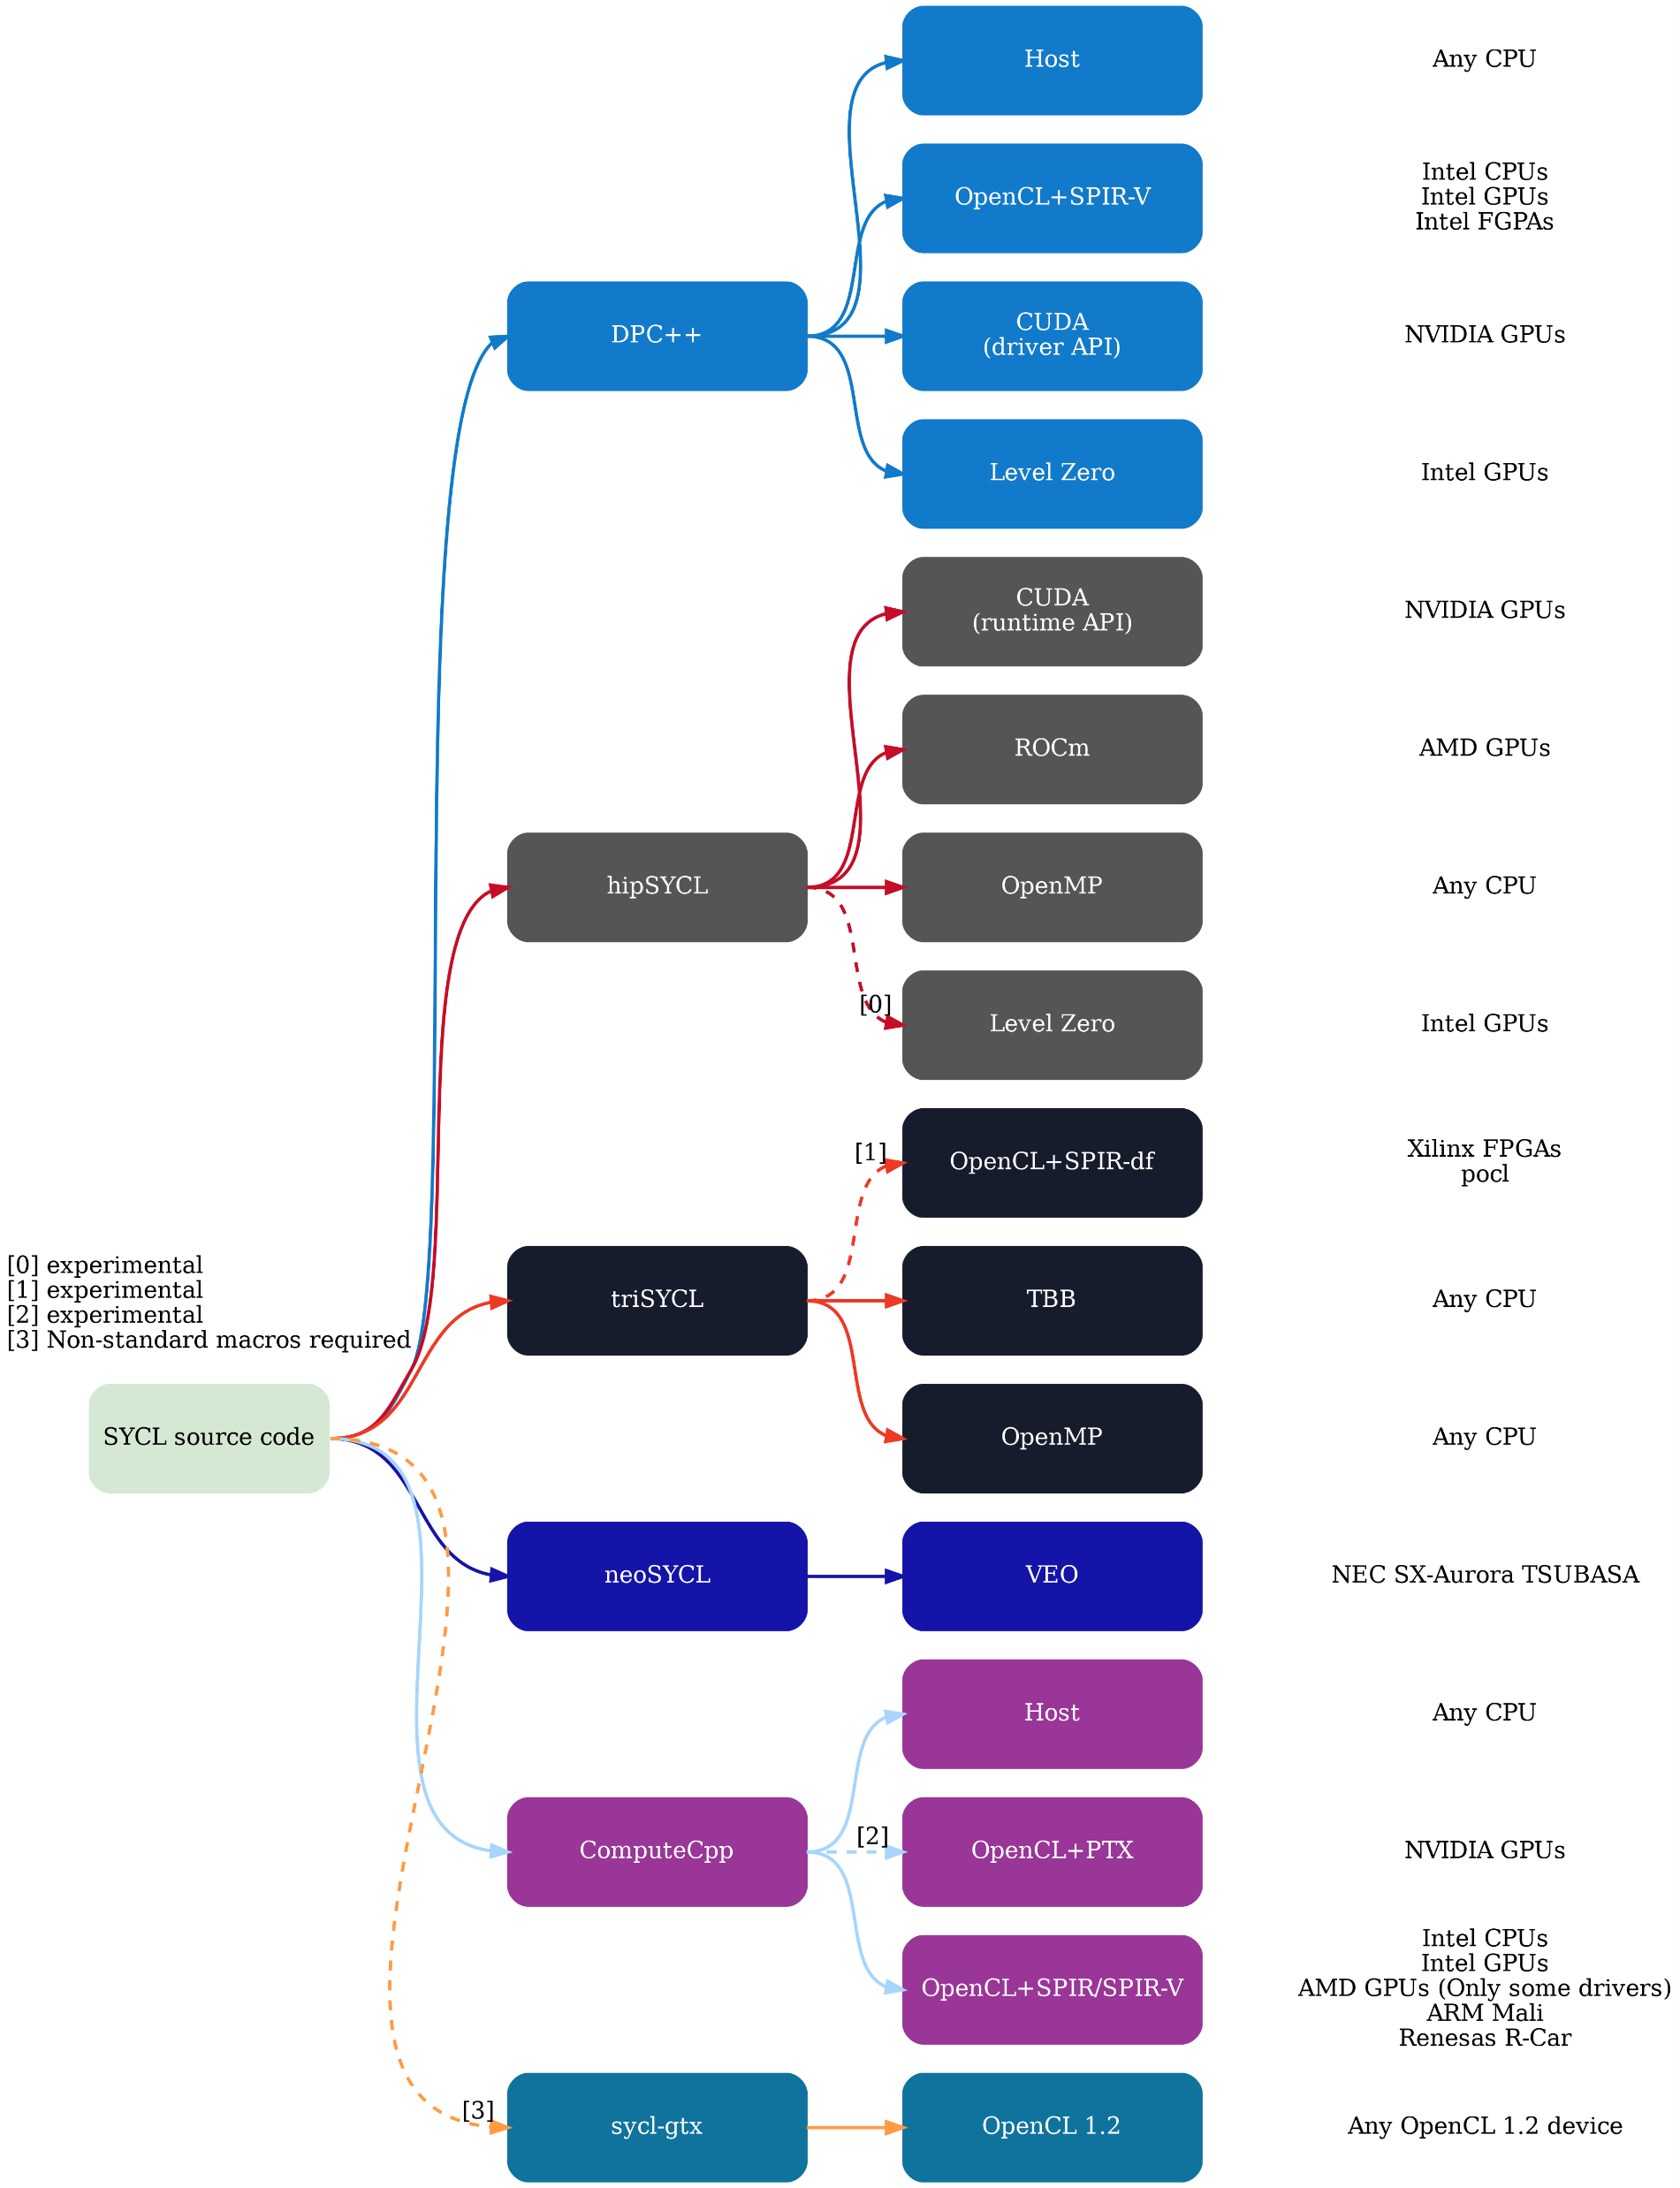
2020
Adoption of SYCL 1.2.1 was held back by the adoption of SPIR-V across the OpenCL ecosystem
SYCL 2020 introduces
  Non-OpenCL back-ends via generic interop system
  Universal Shared Memory to capture host-side memory
  Improved buffer, accessor, host-task interfaces
  Built-in device-side algorithms
  Minimally C++17 conformant
WHAT HAS CHANGED?
https://github.com/illuhad/hipSYCL/

Slide 20
IN ACTUAL NEWS
GROMACS deprecating their OpenCL back-end
GROMACS adopting SYCL as a back-end
¯\_(ツ)_/¯
  Loss for OpenCL? Win for SYCL? Win for Khronos?
Every project can use the standard which makes the most sense to them
  SYCL is more similar to CUDA, starting with a similar single-source compilation model and C++ friendly API
  Projects that require a stable ABI (C++ is nothing but), allow simpler compilation model will favor OpenCL
  No one size fits all!
WHAT HAS CHANGED?

Slide 21
set<khronos::standard>
OpenCL can go places SYCL can’t
WHAT HAS CHANGED?
SYCL will go places OpenCL won’t
Notes:
Both technologies can get the job done, but in most cases one is a better match than the other.

Slide 22
CATALYZING ADOPTION
Open-source algorithm and domain libraries
  AMD ROCm’s rocPRIM (development spearheaded by Stream HPC)
    Serves as the common back-end to rocThrust a hipCUB
    Prime inspiration for any other lib how to
      Parametrize algorithm implementations
      Tune for GCN/RDNA architectures
  Domain libraries
    vkFFT has proved itself on various vendor’s hardware
    oneMKL has a wide assortment of libraries, all open-source and cross-vendor
    Existing clMath libraries are still full functional (and perform reasonably well)
Porting domain frameworks
  Stream HPC took part in porting Gromacs, NAMD, Amber-MD to HIP
WHAT HAS CHANGED?

Slide 23




CHOICE IS KEY
WHAT HAS CHANGED?
Notes:
Ideally standards and propriatary solutions coexist giving options: vendors need technologies they control, where they can experiment and tailor the experience to their needs. Standards exist to provide portability and reduce costs. The HPC landscape has always been turbulent and navigating it is domain expertise.

Slide 24
WE’RE HIRING
https://streamhpc.com/jobs/

